Slide 1

Title (Provide an innovative Name to your product)
Group Details
Name of students | BITS ID
Alok Narayan | 2020A4PS0501P
Chaitanya Krishna Chauhan | 2020A4PS1869P
Samikhya Nayak | 2019B5A40845P
Yash Anil Saboo | 2020A4PS0465P

Slide 2
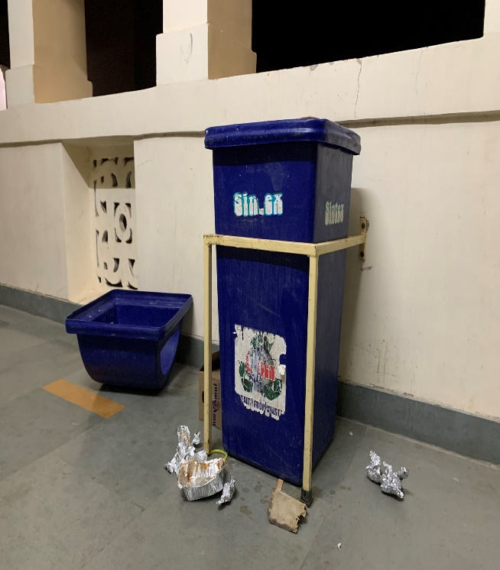
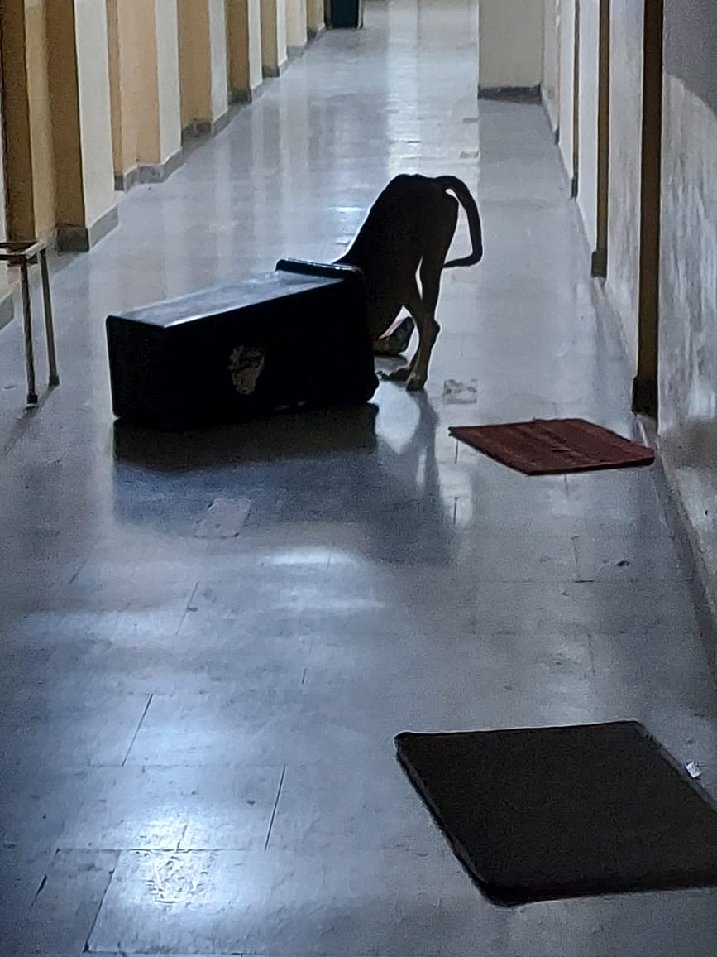
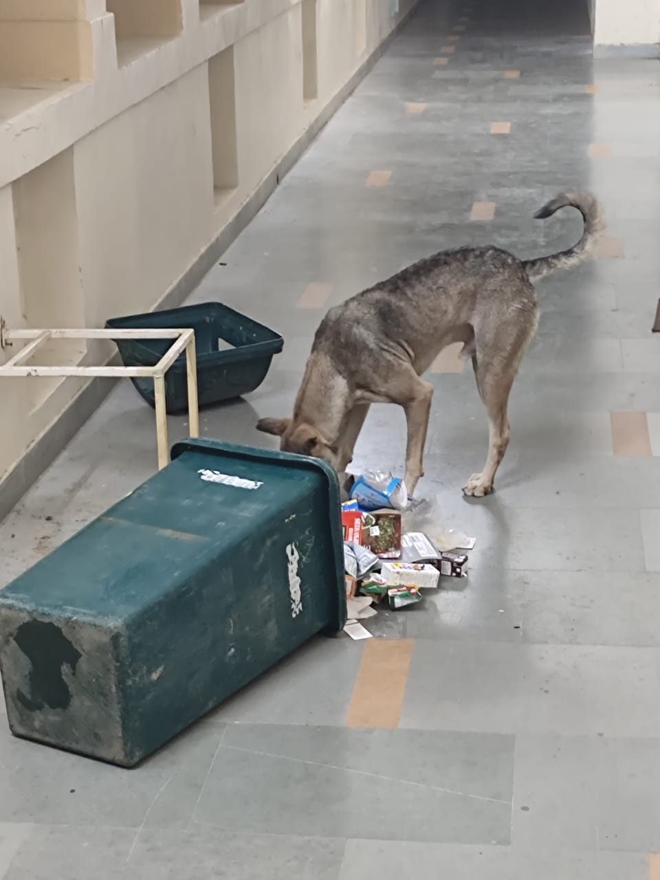
Identified Problem
Many-a-times, when you go in the corridor of bhavans, you will see dustbins being tossed out of their stands. And the garbage in them spread all over the place
Also, emptying the garbage by hands poses a health hazard for the cleaning staff.
This is problematic for both the students and the cleaning staff

Slide 3
Proposed Solution
Method uses hinge, handle and gears to control the handling of the dustbins, thus avoiding direct contact
Once the hinge is moved downward, the handle can be used to rotate the dustbin about its axis.
Otherwise, the hinge restricts any motion of the handle which then blocks the rotation of the dustbin itself.
To prevent the cover of the dustbin to come off by accident, a small clip in the shape of a hook is installed on two opposite sides, which can be easily flipped to remove the cover, but preventing the lid from coming off by dogs.

Slide 4
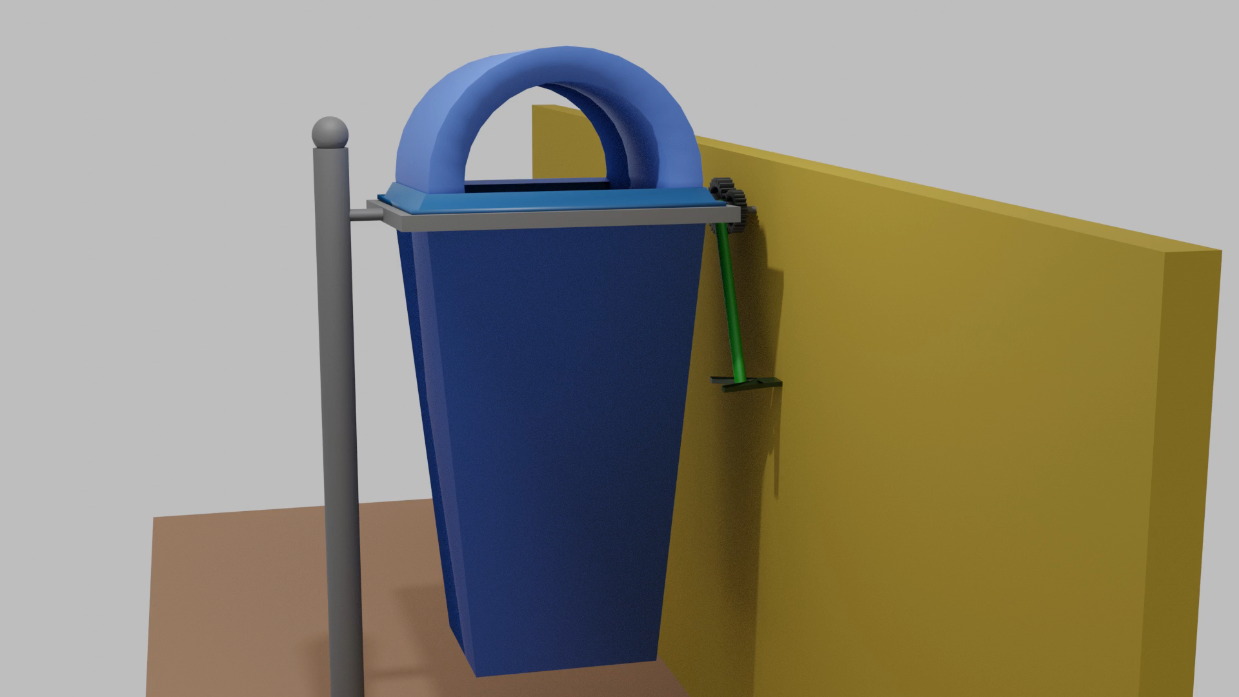
Proposed Solution

Slide 5
Product Realization
Support Rod- Made of 2x2 cm, hollow mild steel bar, 80cm length, thickness 4mm
Square Rim- Made of 2x2 cm, hollow mild steel bars, 36cm each, thickness 4mm, 4 bars needed
Connecting Rods- Made of 1.5 cm diameter, solid mild steel rod, 13cm length, 3 rods needed
Spur Gears- Made of S45C steel, internal diameter of 1.5cm, No. of teeth on 1 gear-24, No. of teeth-32
Hooked Clip- 5cm in length
Y-Shaped Clip- 5cm in length
Handle- Made of 1.5cm diameter, hollow mild steel rod, 40cm in length
Hinge- 3 Strut Hinges

Slide 6
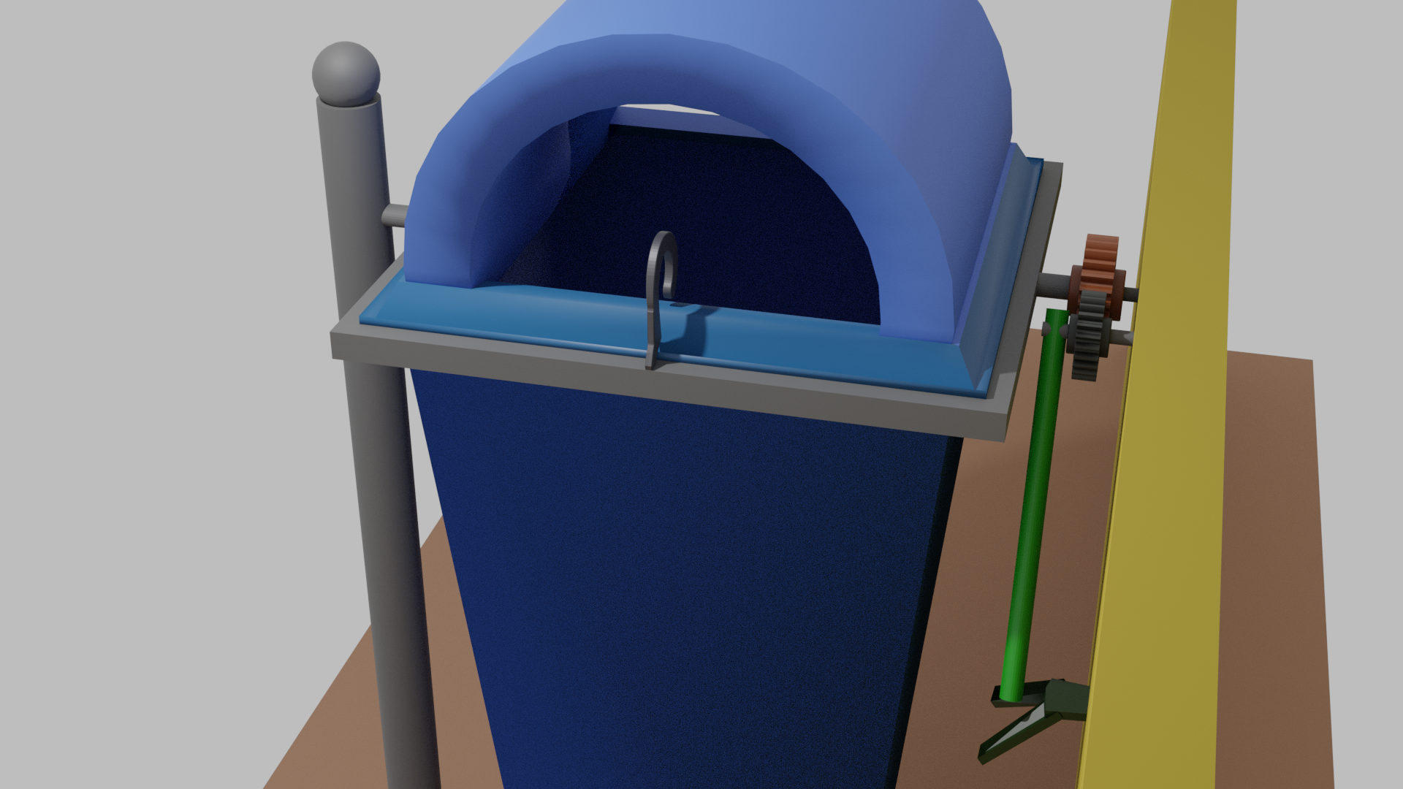
Product Realization
Connecting Rod
Connecting Rod
Gear 1
(24 Teeth)
Support Rod
Square Rim
Hooked Clip
Gear 2
(32 Teeth)
Dustbin
Y-shaped Clip
Handle
Floor
Advanced Manufacturing Process (ME F315)
6

Slide 7
Manufacturing Strategy
Material Identification
Most parts are manufacture from MS
It has some very desirable properties such as good weldability and machinability, considerable strength, good malleability with cold forming possibilities and cost effective.
Clips are made from stainless steel since they are generally not painted which can prevent their corrosion.
Manufacturing Processes
Support Rod- Flexible Cold Forming, followed by MIG welding to form bar from sheet metal
Square Rim- Same as support rod first, then welding 4 rods formed by MIG Welding
Connecting Rod- Extrusion of Mild Steel block
Spur Gears- Sand casting with post casting machining, but shell mould casting can be used for improved dimensional accuracy
Both Clips- Both clips can be formed by laser beam machining
Handle- Same as support rod

Slide 8
Approximate Cost
Material Acquisition
Support Stand – 1 long Mild steel sheet at the rate of ₹60/kg of sheet
Square Rim – 2 Mild steel sheet at the rate ₹50/ kg of sheet
Connecting Rods – Mild steel rods at ₹30/kg
Two Spur gears – S45C ₹200/gear
Clip - ₹10 per Clip
Handle – ₹56/kg
Y-Shaped Clips – Mild steel sheet ₹80/Kg
Hinge – ₹345 for 3 Strut Hinges
Total Cost for material acquisition= ₹1091 (approx.)

Slide 9
Individual Contribution
Name of student | Contribution (activities performed) | Involvement (in %)
GL: Alok Narayan | Manufacturing Strategies, Finding Cost | 25
M: Chaitanya Krishna Chauhan | Problem Solution, Animation for the solution, Product Realization | 25
M: Samikhya Nayak | Product Realization, Finding approximate cost | 25
M: Yash Anil Saboo | Problem Identification, Documentation | 25

Slide 10
Thank you

